Slide 1
WASTE MANAGEMENT AND RECYCLING ANALYSIS
Submitted by
Resmi A
Techolas Technologies
Cochin

Slide 2
INTRODUCTION
Waste management in Indian cities is a major challenge due to the country's rapid urbanization and population growth. The current system is inefficient and leads to improper disposal, which poses health and environmental risks.
The amount of waste generated has increased due to population growth and urbanization. About 90% of waste is disposed of unscientifically in open dumps and landfills.
Recycling is limited, and the informal sector plays a key role in extracting value from waste. India is a diverse country with many different cultures, traditions, and religious groups, which complicates the implementation of uniform waste management strategies.
This analysis delves the efficiency of waste management and recycling in Indian cities. It includes key data related to waste generation, recycling rates, population density, municipal efficiency, landfill details, and more. The data spans multiple years (2019–2023) and covers a range of waste types, including plastic, organic waste, electronic waste (e-waste), construction waste, and hazardous waste.

Slide 3
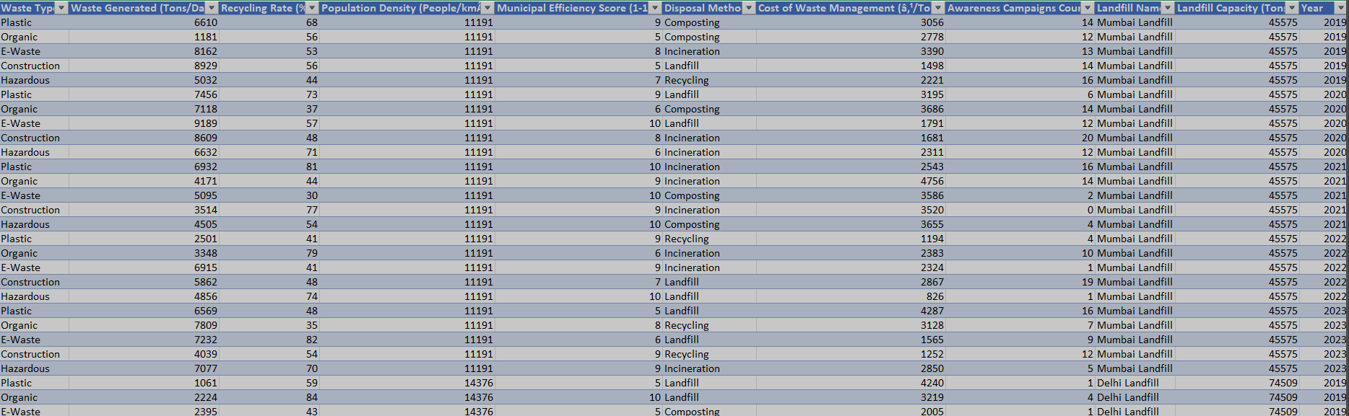
DATASET

Slide 4
DESCRIPTION
City/District: The name of the Indian city or district.
Waste Type: Type of waste generated, e.g., Plastic, Organic, E-Waste, Construction, Hazardous.
Waste Generated (Tons/Day): Amount of waste generated in tons per day.
Recycling Rate (%): The percentage of waste that is recycled.
Population Density (People/km²): The number of people per square kilometer in the city.
Municipal Efficiency Score (1-10): A score indicating how effectively the municipality manages waste (e.g., waste segregation, collection, disposal).
Disposal Method: The method used for waste disposal (e.g., Landfill, Recycling, Incineration, Composting).
Cost of Waste Management (₹/Ton): The cost of managing one ton of waste in Indian Rupees.
Awareness Campaigns Count: The number of awareness campaigns organized by the municipality in that year related to waste management.
Landfill Name: The name of the landfill site used by the city.
Landfill Capacity (Tons): The total waste capacity (in tons) that the landfill can hold.
Year: The year of the data entry, ranging from 2019 to 2023.

Slide 5
CALCULATED FIELD
Waste efficiency (New column) : Recycling rate(%) / Municipal efficiency score

Slide 6
CRITERIAS USED
City wise waste efficiency on disposal methods : Clustered bar chart
Sum of cost of waste management : Stacked bar chart
Sum of waste generated by year : Line chart
Cost of waste management VS recycling rate : Area chart
Waste type proportions : Pie chart
Sum of waste generated : Card
Year : Slicer

Slide 7


REFERENCE
www.kaggle.com/datasets
Visualization

Slide 8
DASHBOARD USING THIS DATASET

Slide 9
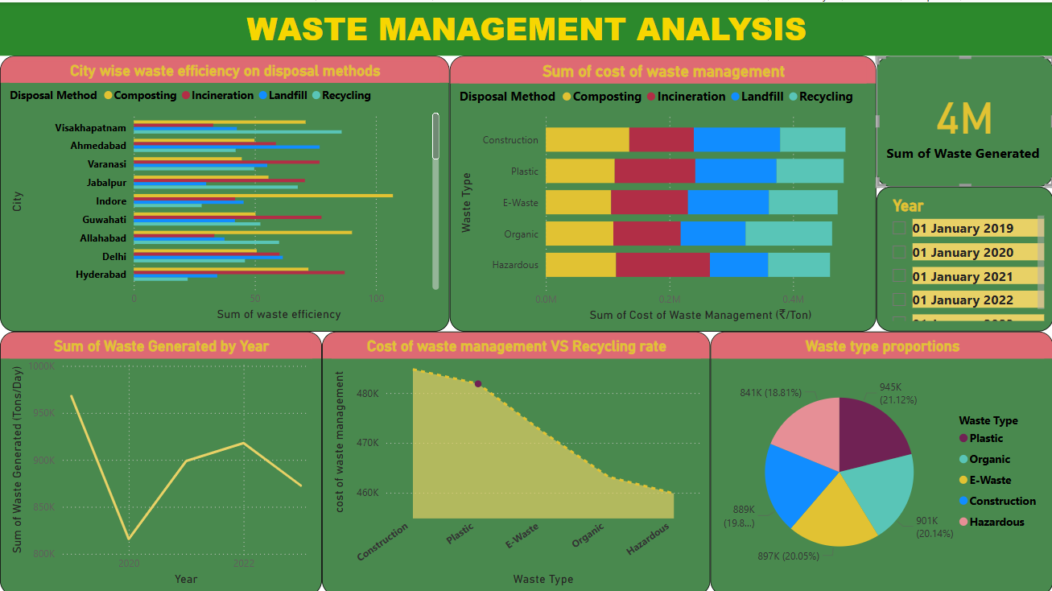

Slide 10
CONCLUSION
The most generated waste in Indian cities are plastic waste (21.21%) over the years.
Also plastic waste has the greatest recycling rate(98%).
Composting disposal method has more efficient method in the waste management mainly in the city Indore.
Landfill is the more done disposal method for construction waste , plastic and E waste.
Recycling is the most efficient method for organic waste however incineration for hazardous waste.
In the year 2019(9697889 Ton) the waste generated was higher when 2020(813784 Ton) was the lowest . Over the year of 2023(872373 Ton) generation of waste decreased slightly.

Slide 11
APPLICATION
Urban Planning: The dataset can be used to analyze and optimize waste management infrastructure in urban areas.
Sustainability Research: It can help in studying the progress of recycling and waste reduction strategies.
Policy Making: Government bodies can use this data to craft policies aimed at improving waste management and recycling rates.
Machine Learning/AI: The dataset can be used to build models for predicting waste generation trends, recycling outcomes, and municipal efficiency.

Slide 12
THANK YOU

